Slide 1

Motivation
I have played a lot of different board games, so I thought it would be a fun idea to showcase the massive number of games I played by creating a board-game-themed visualization!

Slide 2
Brainstorm
I want the gameplay mechanic to be intuitive to people who have never played board games before, and the first thought that comes to mind is to recreate a simplified version of Monopoly.

Slide 3
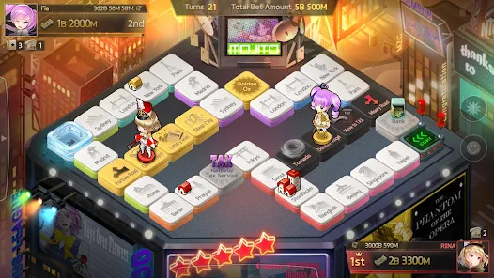
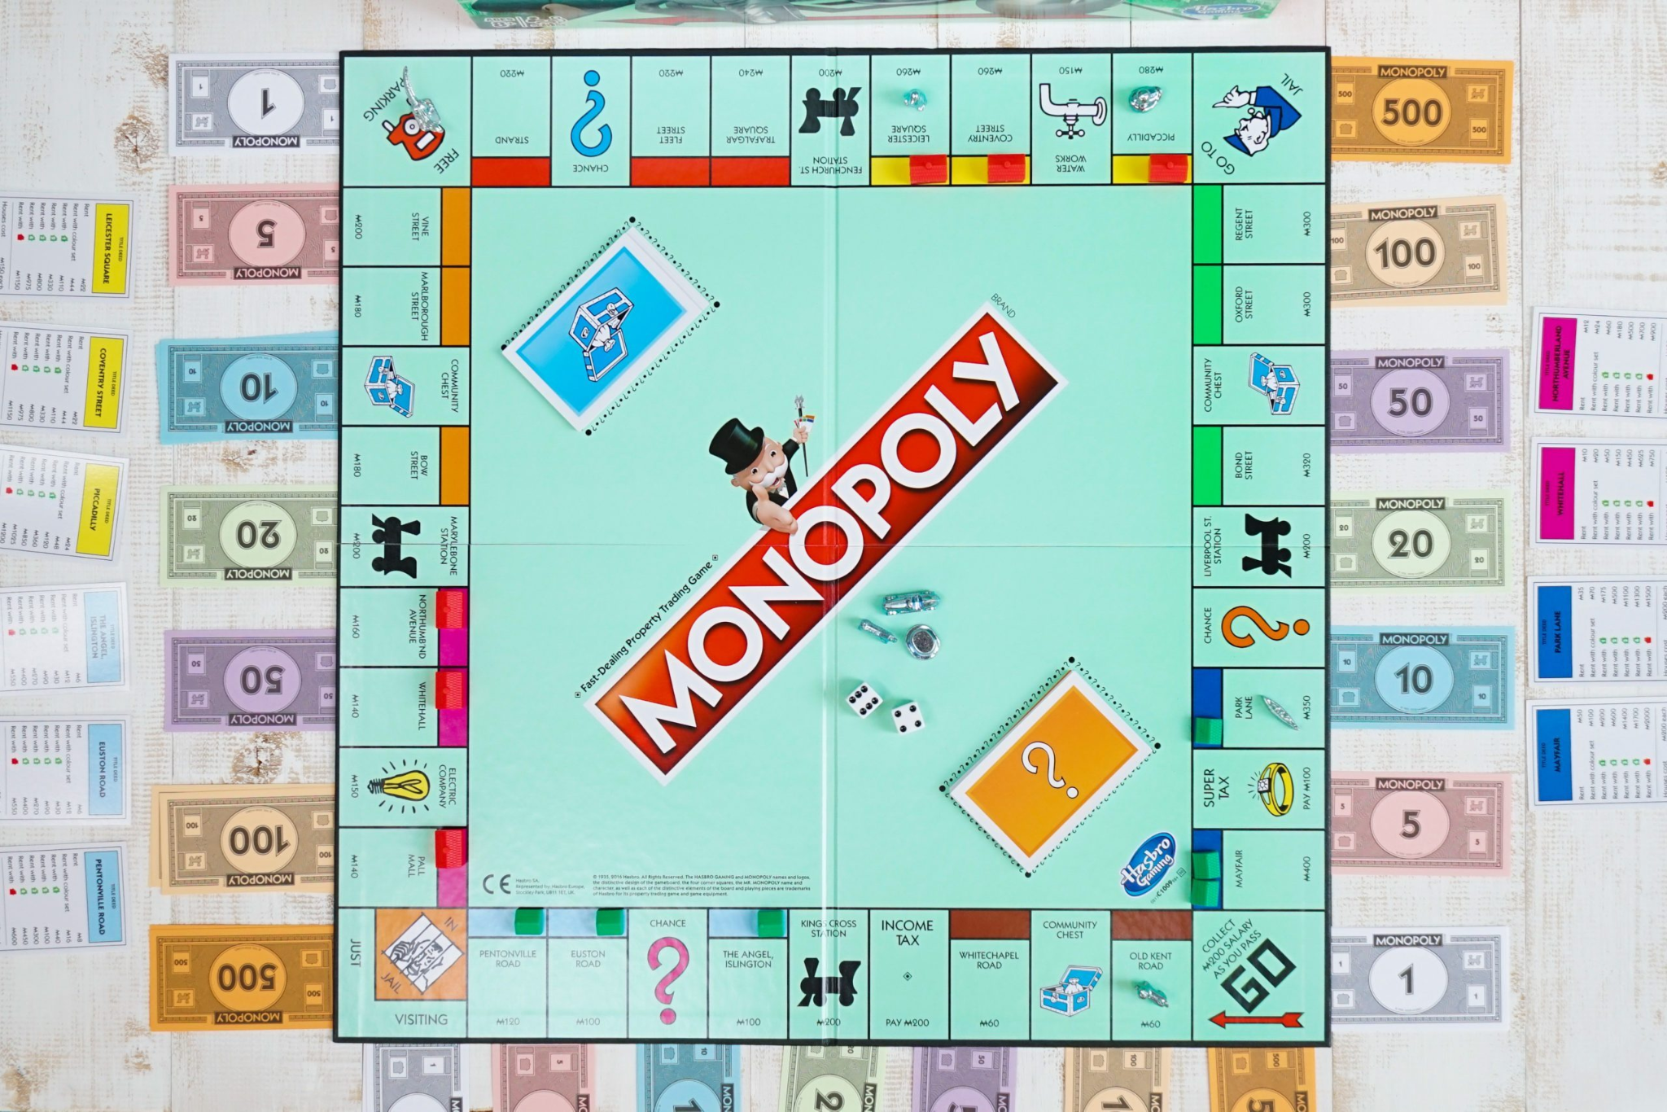
Iteration 1
As evidenced by these two images, my game will involve a character moving around a board

Slide 4
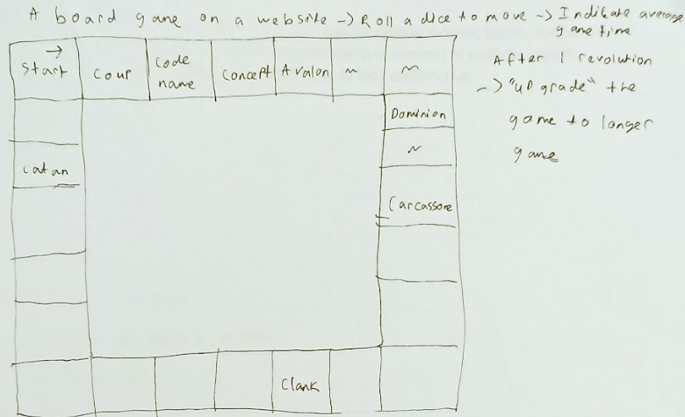
Draft 1
I developed a rough paper draft of the board game

Slide 5
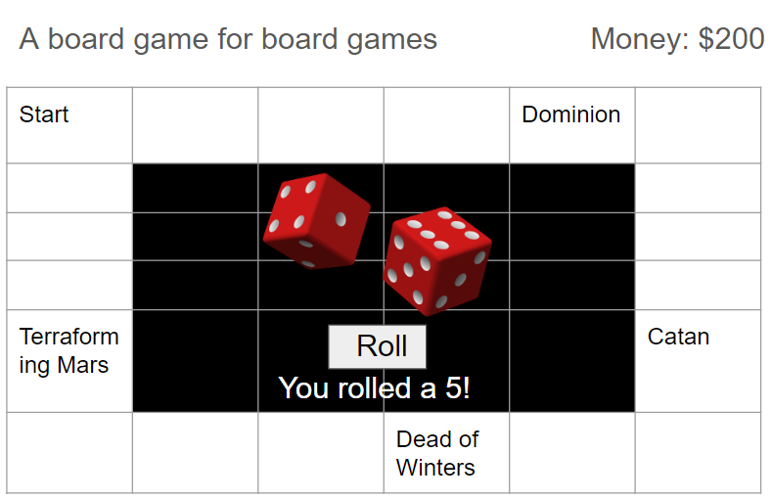
Draft 2
I then proceeded to create a more refined visualization model in PowerPoint.

Slide 6
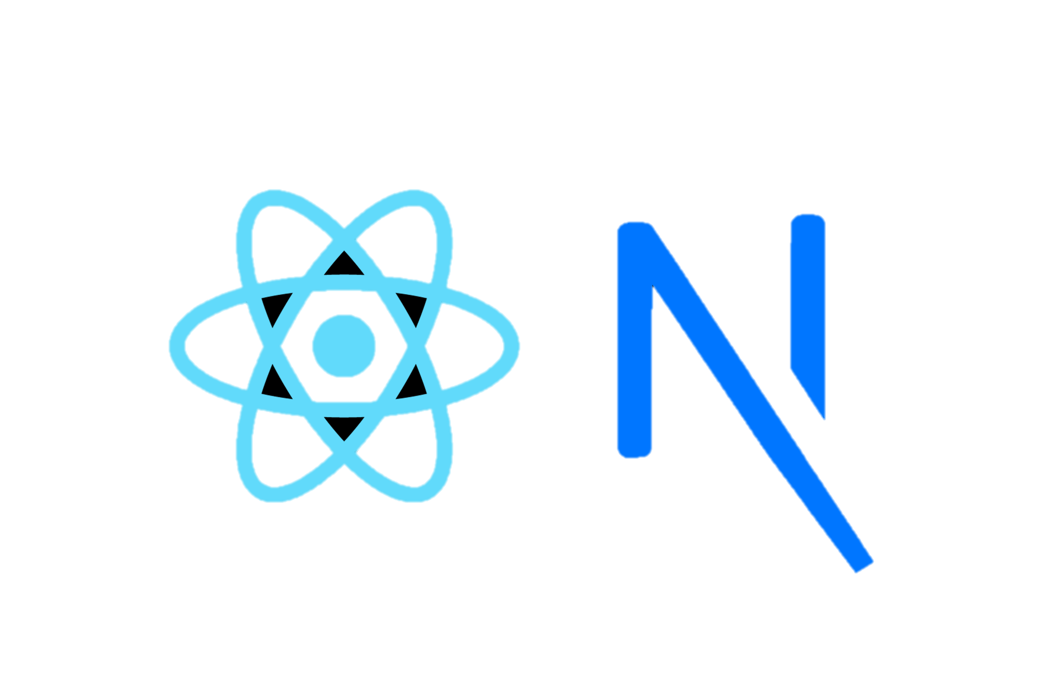
Tool
In developing my visualization, I opted to use a framework that I’ve recently learned called Next.js with React.js which simplifies and hasten page navigation.

Slide 7
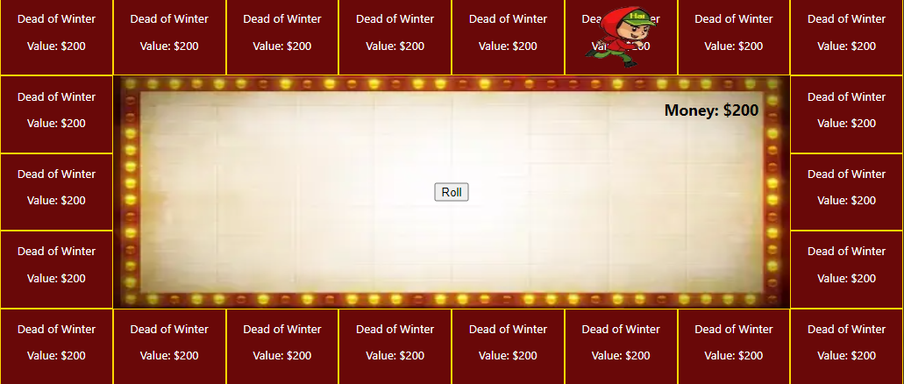
Process 1
As development is an iterative approach, I begin programming this application by create a background and gameboard.

Slide 8
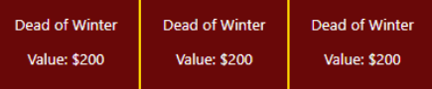
Process 2
Using object-oriented programming and polymorphism, I create a class for each Tile with preliminary data such as game duration, complexity, and rating, allowing me to easily scale my application.

Slide 9
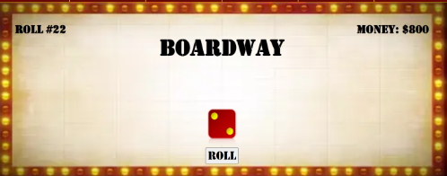
Process 3
Next, I developed the key interaction functionality of rolling a dice and seeing incrementing roll # and money as the player land on different spaces.

Slide 10



Process 4
Once the key functionality is done, I proceeded to refine the visual aesthetic of the application by utilizing CSS hovering animations for the dice, and correct character orientation.

Slide 11
Process 5
From my previous experiences developing and publishing mobile applications, I have learned to always account for variable screen resolutions

Slide 12
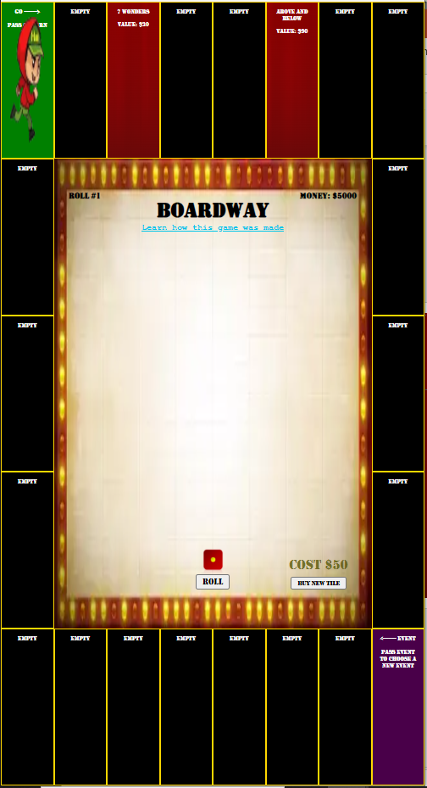
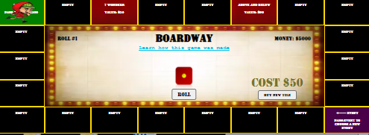
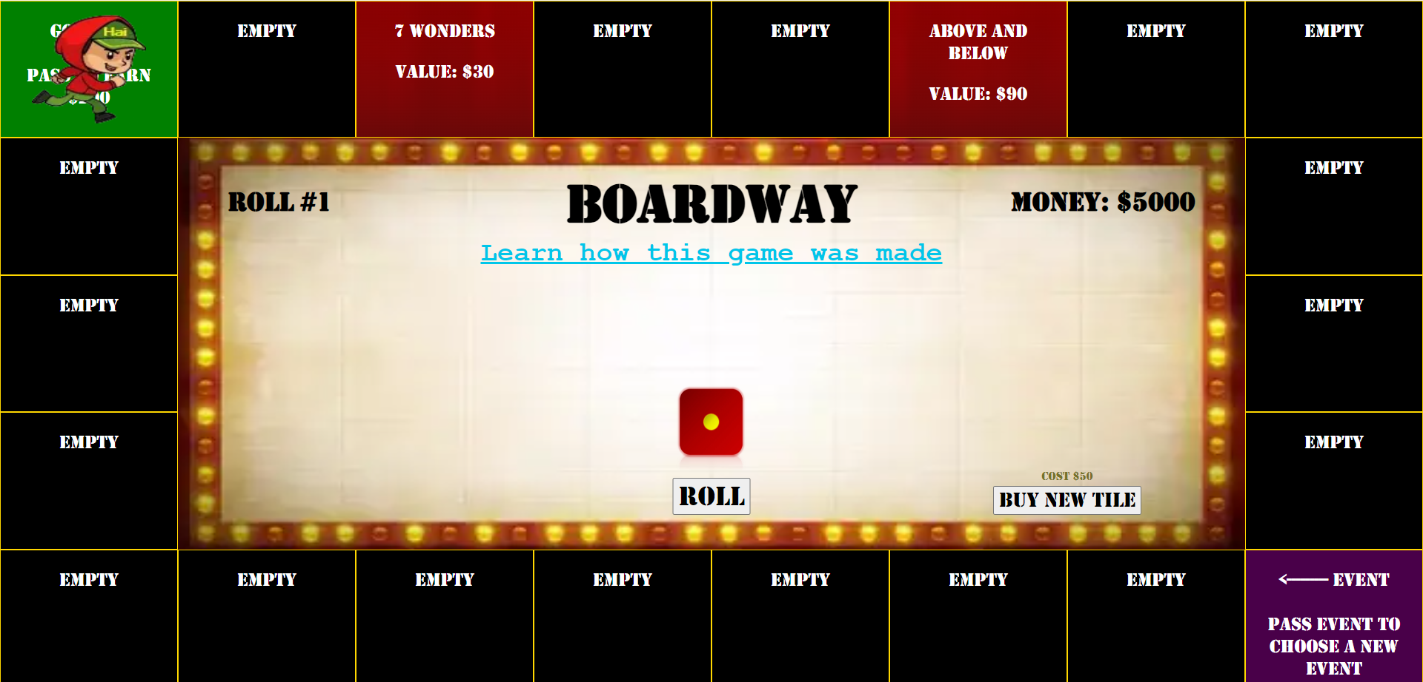
Process 5.1

Slide 13
Iteration 2
The game is functional… but it is not fun. The only interaction is clicking 1 button and rolling a dice, how can I add more interaction?

Slide 14
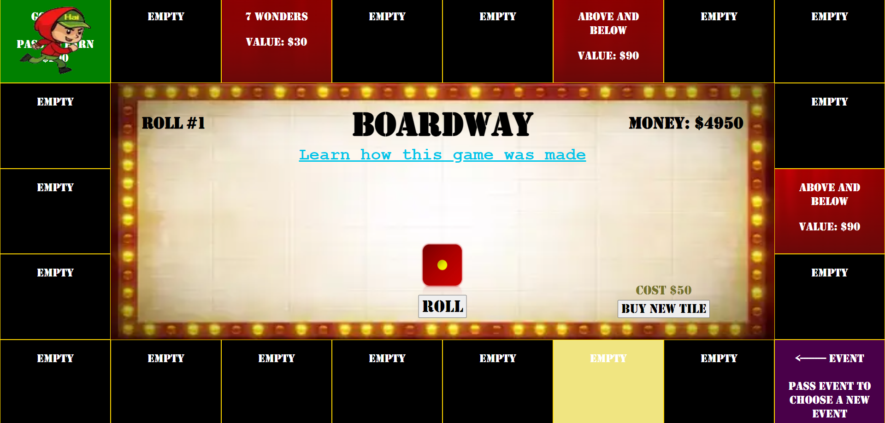

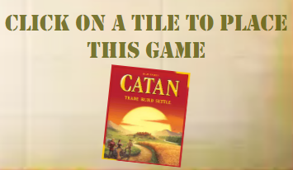
Inspiration 2
Build your own board!
The player can now buy tiles and placing them on the board. I also added a tile highlighting and image tilting feature.

Slide 15
Iteration 3
Now the player can move around the board and place tiles, it is more interactive now, but something is still lacking… you can create a beautiful board, but where’s the strategy?

Slide 16
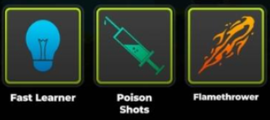
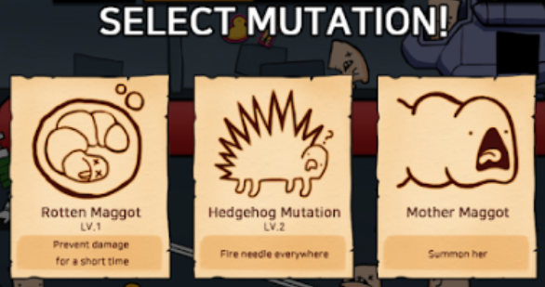
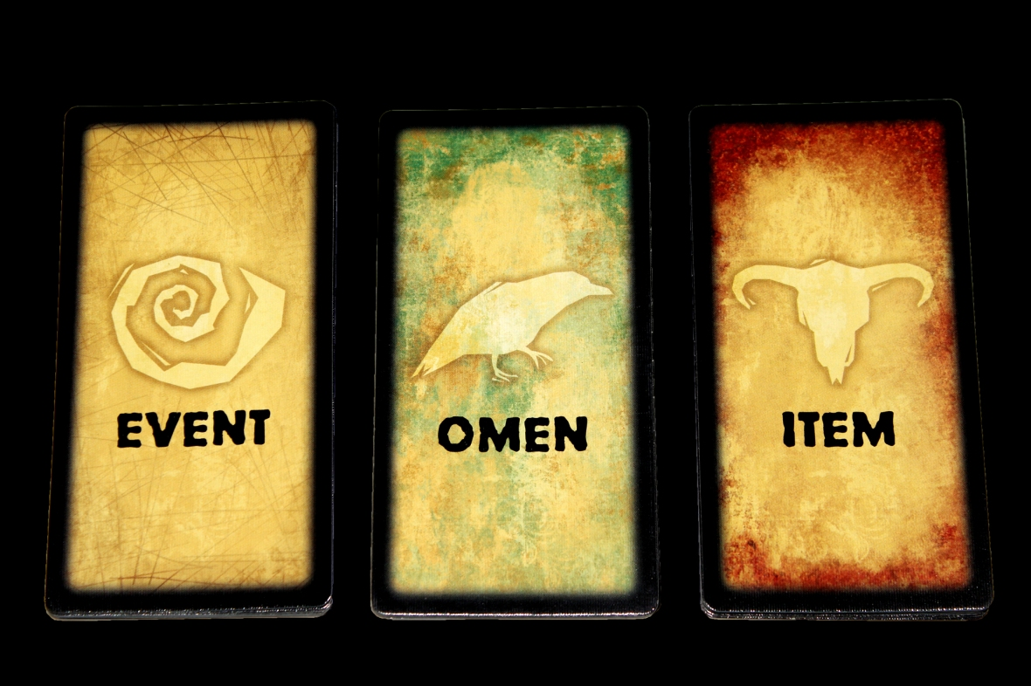
Inspiration 3
To make the game more exciting, I incorporated a mechanic predominant in top-grossing casual mobile games: progression by selecting between 3 different upgrade.

Slide 17
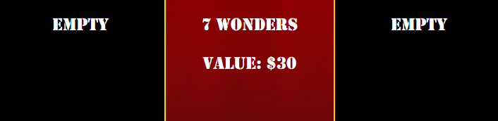
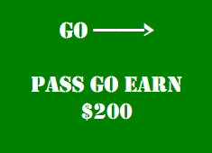
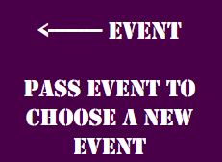
Process 6
I proceeds to design 2 tiles that activate when the character pass it instead of just landing on it (Go – earn $200 like in Monopoly; Event – choose 1 of 3 events that modify the values of the tiles on the board)

Slide 18
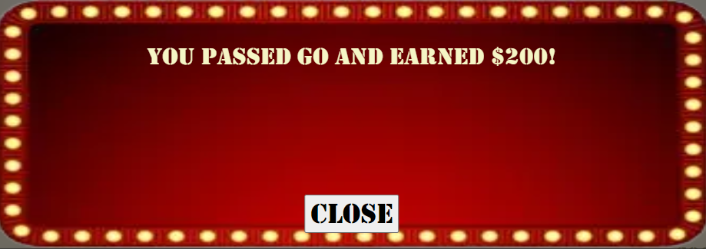
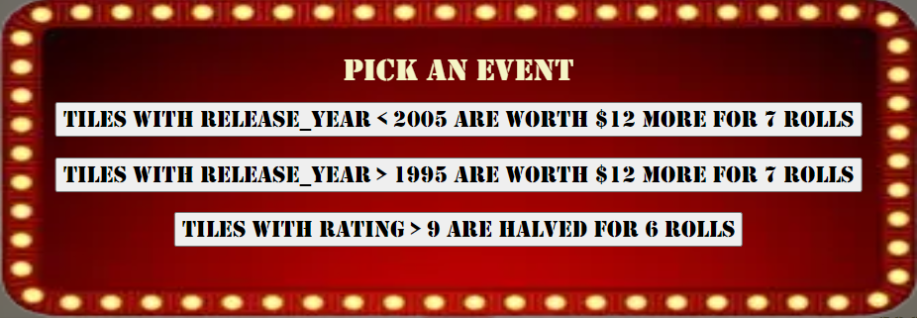
Process 6.1

Slide 19

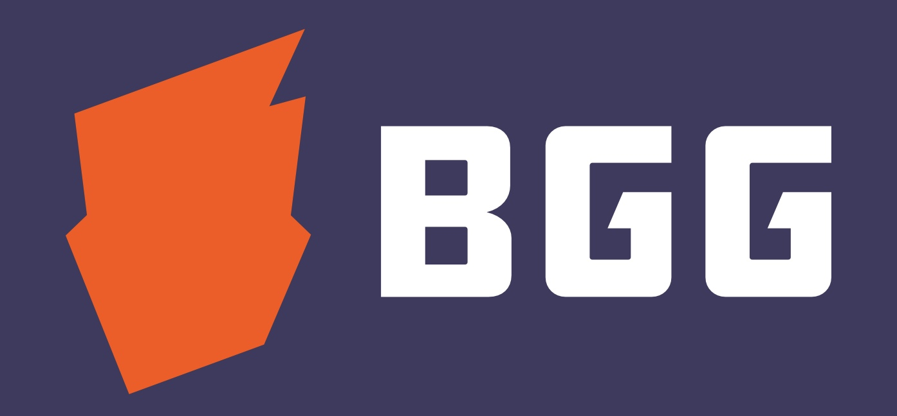
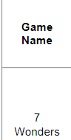
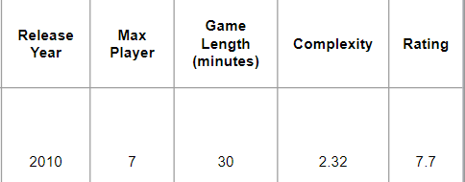
Data Collection
The games that can be bought in this game are games that I’ve played based on message history and inventory list on the Board Game Club Discord server at Georgia Tech.
Information such as game complexity and rating are retrieved from boardgamegeek.com.

Slide 20
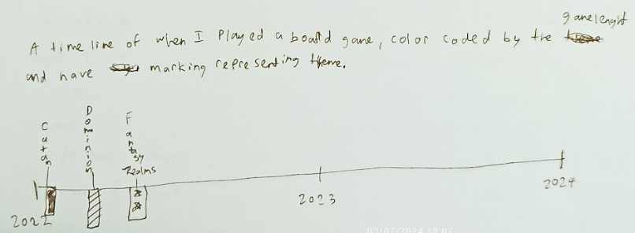
Alternative Draft
Throughout my pre-planning phase, I have also drafted another style of data visualization, which aligns more closely with recommended visualization practices: a timeline

Slide 21
Rubric
Unconventional format – board Game as a form of data visualization
Inverting Visualization Best Practice – Delayed information display to fit with gameplay mechanic (Best practice is to display information immediately)
Combining unusual dataset – Complexity and Rating data are typically unrelated, creating an inclination toward chance when playing the game.

Slide 22
Conclusion
You’ve reached the end of the board game About journey!
Click “Return to game” and starts playing!

